Slide 1
Group 17 Proposal
Amy Qin, Max Zou, Chi Zhang

Slide 2

Motivation
Choose a large US restaurant franchise
Target one store with particularly low customer rating
Build a NLP model to find the areas customers view as important and compare with the particularly low-rated store

Slide 3
Data Processing
1 Chose Subway as object to analyze , since there are 400+ Subways and more than 4000 reviews
2 Merge `business.json` and `review.json` files by business ID for each Subway
3 We combine the review for each subway by address the data looks like this:
Index | Address | Star | Text
0 | 1 Brookings Dr | 2.0 | I repeated my order three times loudly and you.. I assume this is the one inside the Mallinckro... ...
... | ... | ... | ...
458 | 4882 Sun City Center Blvd | 4.0 | Every time I go in there you can cut the tensi... It's subway, you should know what to expect fo...

Slide 4
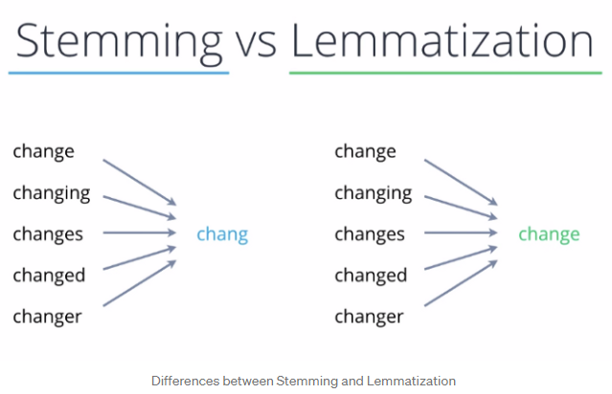
Data Processing
4 Clean review text data
NLTK package
Remove punctuation and stop words
Tokenization and lemmatization
Calculate overall and individual restaurant word count and word frequency

Slide 5
Exploratory Data Analysis
Index | Address | Star | clean | service | good | ...
0 | 1 Brookings Dr | 2.0 | 0 | 5 | 1 | ...
1 | 1 Hermitage Ave | 2.5 | 0 | 0 | 0 | ...
... | ... | ... | ... | ... | ... | ...
458 | Unit No G5 | 1.5 | 1 | 1 | 1 | ...

Slide 6
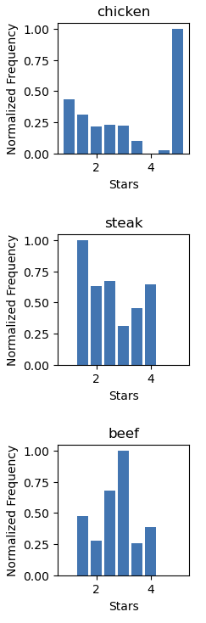
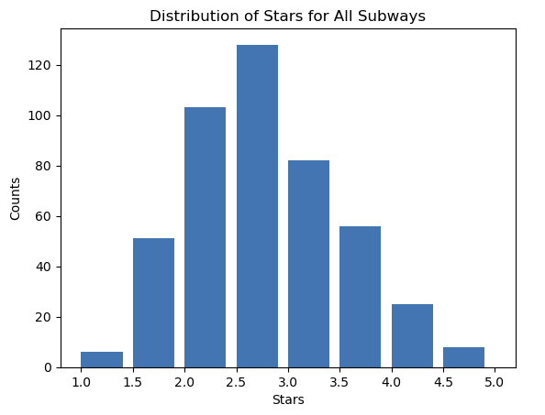
Exploratory Data Analysis

Slide 7
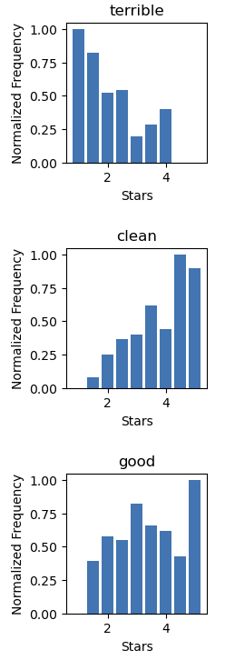
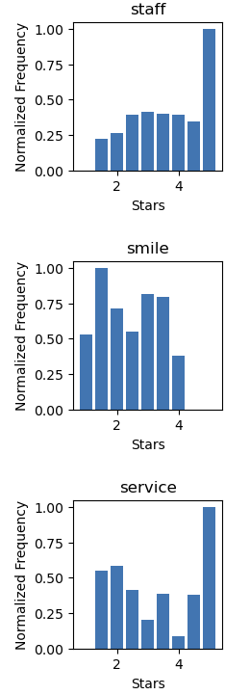
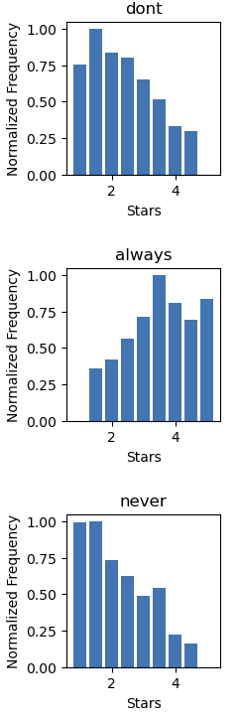
Exploratory Data Analysis

Slide 8
Difficulties & Next Steps
Difficulties:
How to determine context of each word: N-gram
Amounts of words to include
Next steps:
1. Chi square goodness of fit to choose words (features) as variables
2. Use the variable we choose to fit a linear regression model

